Slide 1





BUSINESS & TOURISM
2026 COURSE OFFERINGS
1300 303 715
admin@binnacletraining.com.au
binnacletraining.com.au

Slide 2


THE BINNACLE MISSION
We are leaders in Vocational Education in schools; enabling teachers with high quality certificate programs and support; equipping students with skills to navigate a successful future.

Slide 3

ALLOWING TEACHERS TO TEACH
Our Binnacle Certificate Courses are suitable for students in Years 10-12 across 1, 2 and 3-Year Pathways.
Choose from a variety of Certificate II, Certificate III and Short Course Pathways from a range of study areas including:
Fitness, Sport and Recreation, Business, Tourism and First Aid.
HOW TO GET STARTED:
Please visit our Binnacle Training Website - Programs for Schools for more information on each of our course offerings:
binnacletraining.com.au/for-schools/programs/
1300 303 715
admin@binnacletraining.com.au
binnacletraining.com.au

Slide 4
WHY STUDY WITH BINNACLE TRAINING?
More than 19 Years of Experience Delivering VET in Schools | More than 500 Active Classes State-Wide
5 x National Recognised Certificate Pathways Offerings - Sport, Fitness, First Aid, Business & Tourism PLUS Short Courses | 15,000 Qualifications Issued Approximately Each Year
Over 15 Certificate Programs Offered Each Year | 4 Office Locations - Ipswich, Brisbane, Rockhampton and Townsville
Over 250 Binnacle Partner Secondary Schools | Servicing Secondary Schools across Queensland & ACT
Over 800 Binnacle Program Deliverers | 91% Completion Rate
Binnacle Training are leaders in VET in schools, enabling teachers with quality programs and support; equipping students with skills to navigate a successful future. We are united in our commitment to ‘raising the bar’ with the following highlights showcasing our impressive record:

Slide 5

REAL SKILLS FOR REAL CAREERS
Custom-Built, Student and Teacher Friendly Online Learner Management System (LMS) | Flexible and Student-Friendly Programs Delivered in 1, 2 and 3-Year Formats
Certificate Programs Purpose Built For Secondary Schools (Years 10-12) By Industry and Education Experts | Practical Learning and Project-Based Learning assisting students to acquire key enterprise skills for future world of work
Binnacle Certificate Programs Contribute to a students QCE Credits and ATAR Ranking | Live and Up-To-The-Minute Student Feedback and Progress Reporting - Take the stress out of teacher marking
All Teaching and Assessment Resources Developed for Teachers to save your time and ‘Allow Teachers To Teach’ | World-class Teachers Professional Development Opportunities (Workshops, Webinars, ViSC Conference)
Programs Delivered By Industry-Qualified Trainer and Assessors (Teachers) in a familiar School Environment | Dedicated Teacher and Customer Support Team - Direct Access to Program Management and Admin Support Team

Slide 6

VET IN SCHOOLS
VET in Schools is about gaining practical work-related skills to equip you for the world of work while you are at school.
All VET training embedded in Queensland Curriculum and Assessment Authority (QCAA) subjects and school-based apprenticeships and traineeships count towards a VET qualification as well as the QCE; in effect, allowing students to mix general and vocational education, and make a start on training for a career before they leave school.
As well as readying students for the workforce, VET programs can lead to further study, either in the VET sector (where students can gain credit for their VET certificate) or University.
The number of schools and students involved in VET programs has increased in recent years and most schools now offer some VET options to Senior Secondary Students.
According to the latest data from the National Centre for Vocational Education Research (NCVER), the number of school students undertaking vocational education and training (VET) as part of their senior secondary certificate of education in Queensland increased by 14.4 percent in the 2021 year. Significantly, this is 10.2 percentage points higher than the increase nationally.
NCVER 2022, VET in Schools 2021, NCVER, Adelaide.

Slide 7
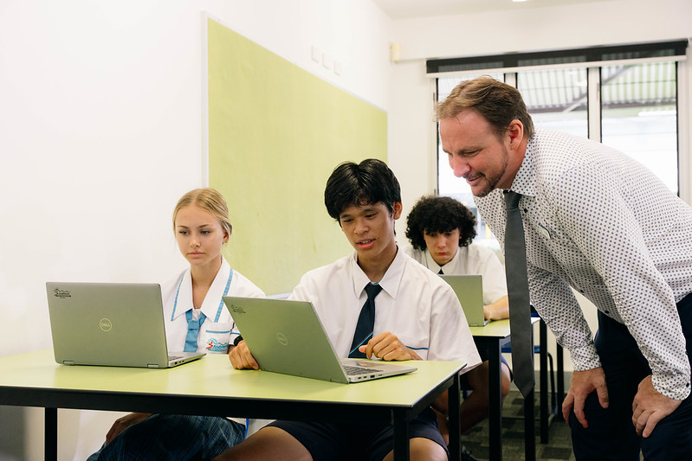
ATAR AND QCE CREDITS
Achievement of a VET Certificate III or above, in combination with results in General Subjects, can contribute to the calculation of a student’s Australian Tertiary Admission Rank (ATAR).
WHAT ARE QCE CREDITS?
VET courses also contribute towards a student’s Queensland Certificate of Education (QCE) which is Queensland’s Senior Secondary Schooling Qualification. To receive a QCE, Queensland students must achieve the set amount of learning which is 20 credits, which can include VET qualifications. Please see our Program-specific sections for more information regarding maximum QCE credits derived from VET qualifications offered by Binnacle Training to Queensland Senior Secondary Students.

Slide 8
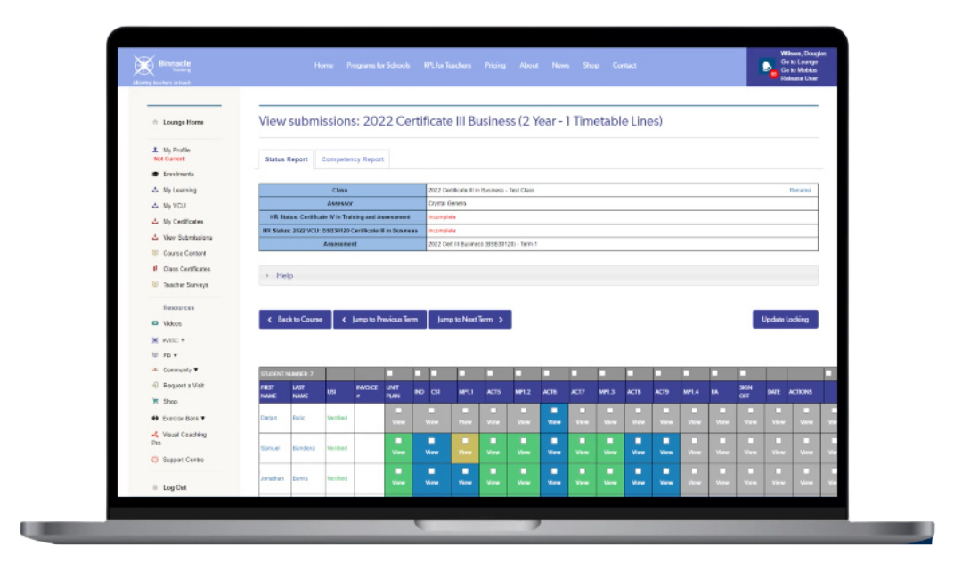
BINNACLE LOUNGE
(LEARNING MANAGEMENT SYSTEM)
The Binnacle Lounge provides:
Real-time status reporting on student outcomes specific to your program
Certificate on completion (a simple download)
All course content in one central location
Interactive online learning including program and tutorial videos
Zero paperwork
Unlimited access - anytime, anywhere
Online Teacher Profile for streamlined management of HR requirements
Delivered mindfully, we are continually evolving and investing in the Binnacle Lounge (and our digital learning resources) to create great experiences for our students and teachers alike.
In 2023, we were proud to celebrate 10 years of the Binnacle Lounge - our very own Learning Management System (LMS) that has been custom-built for Schools, Teachers and Students. With innovation at the forefront, we have enabled the quality facilitation of our programs with a technology solution without peer in VET in Schools.

Slide 9

BSB20120 Certificate II in Workplace Skills
BUSINESS

Slide 10

BSB20120 Certificate II in Workplace Skills
BSB20120 Certificate II in Workplace Skills
Delivery Format: | 1-Year Format (4 Terms) *Packaged as a 4-Term Format however can be delivered over 2-Years
Timetable Requirements: | 1-Timetable Line
Units of Competency: | 10 (5 Core units, 5 Elective units)
Suitable Year Level(s): | Year 10 (or Year 11 or 12)
Study Mode: | Combination of classroom and project-based learning, online learning (self-study) and practical work-related experience
Cost (Fee-For-Service): | $345.00 per person
QCE Outcome: | Maximum 4 QCE Credits
Students participate in the delivery of a range of project based activities and programs within their school community.
Graduates will be competent in a range of essential business skills including; self awareness/personal effectiveness, effective communication techniques, critical thinking and problem solving, time management, team work, workplace health and safety and participating in sustainable work practices.
An excellent work readiness program where students develop a range of essential workplace skills.

Slide 11
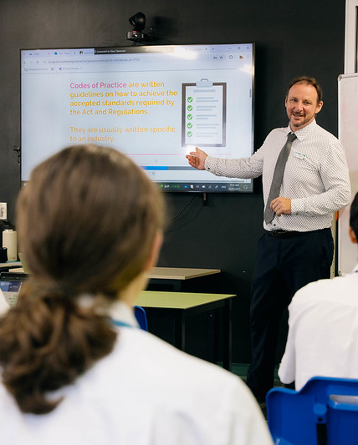

WHAT DO STUDENTS ACHIEVE?
2024 Business & Tourism Course Offerings
BSB20120 Certificate II in Workplace Skills
BSB20120 Certificate II in Workplace Skills
(max. 4 QCE Credits)
A range of career pathway options including pathway into BSB30120 Certificate III in Business

Slide 12
BSB20120 Certificate II in Workplace Skills
BSB20120 Certificate II in Workplace Skills
TERM 1 | TOPICS
 | Introduction to the Business Services Industry Introduction to Entrepreneurship and Business Introduction to Personal Finances
 | PROJECTS
 | Research Business Topics
TERM 3 | TOPICS
 | Working in a Business Environment Time Management
 | PROJECTS
 | Developing Teamwork in the Workplace
COURSE SCHEDULE
TERM 2 | TOPICS
 | Research Topics and Group Presentation Workplace Health and Safety Sustainable Work Practices
 | PROJECTS
 | Group Presentation WHS Processes at the ‘Go! Regional’ Travel Expo
TERM 4 | TOPICS
 | Inclusive Work Practices Workplace Communication
 | PROJECTS
 | Inclusivity and Communication in the Workplace

Slide 13

SKILLS ACQUIRED
BSB20120 Certificate II in Workplace Skills
Personal effectiveness
Communication in the workplace
Using digital technologies in business environments
Critical thinking and problem solving
Time management
Teamwork
Self-awareness
Workplace health and safety
Sustainability

Slide 14
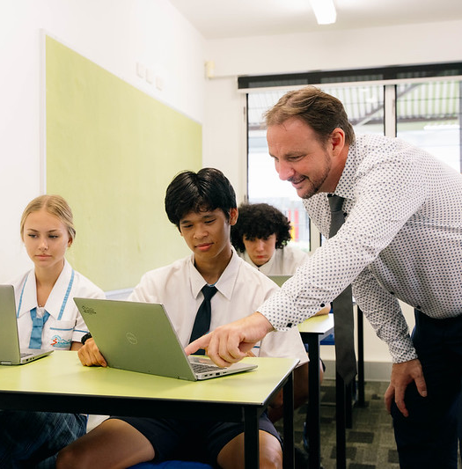
HOW WILL YOU BE ASSESSED?
BSB20120 Certificate II in Workplace Skills
Conducting projects
Completing business documents
Personal reflections and quizzes

Slide 15
CAREER PATHWAYS
BSB20120 Certificate II in Workplace Skills
Certificate II in Workplace Skills
Year 11 and 12 Option
Certificate III in Business
Certificate IV / Diploma
e.g. Business, Small Business Management
Administration Officer
Business Manager
Customer Service Assistant
Customer Service Manager
Marketing Manager

Slide 16
SIT20122 Certificate II in Tourism
TOURISM

Slide 17

SIT20122 Certificate II in Tourism
SIT20122 Certificate II in Tourism
Delivery Format: | 1-Year Format
Timetable Requirements: | 1-Timetabled Line
Units of Competency: | 11 (5 core units, 6 elective units)
Suitable Year Level(s): | Year 10 (or Year 11 or 12)
Study Mode: | Combination of classroom and project-based learning, online learning (self-study) and practical work-related experience
Cost (Fee-For-Service): | $345.00 per person
QCE Outcome: | Maximum 4 QCE Credits
This qualification provides a pathway to work in many tourism and travel industry sectors including travel agencies, holiday parks and resorts, attractions, and any small tourism business.
The program will be delivered through class-based tasks as well as both simulated and real business and tourism environments at the school - involving the delivery of a range of projects and activities within the school community.
This program also includes the following:
Participation in a Tourism-related Industry Discovery (Recommended)

Slide 18
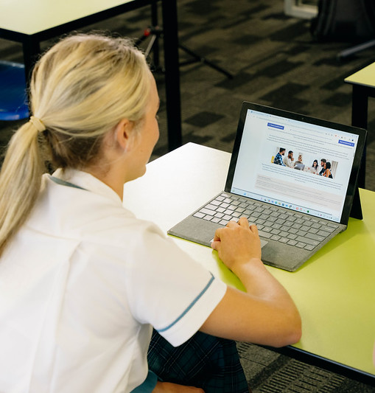
WHAT DO STUDENTS ACHIEVE?
2024 Business & Tourism Course Offerings
SIT20122 Certificate II in Tourism
SIT20122 Certificate II in Tourism
(max. 4 QCE Credits)
A range of career pathway options including pathway into BSB30120 Certificate III in Business

Slide 19
SIT20122
Certificate II in Tourism
SIT20122 Certificate II in Tourism
TERM 1 | TOPICS
 | Introduction to the Tourism Industry Introduction to Entrepreneurship and Business Introduction to the Business Services Industry
 | PROJECTS
 | Research Business Topics
TERM 3 | TOPICS
 | Source, Use and Present Information on the Tourism and Travel Industry Public Activities and Events
 | PROJECTS
 | Tourism Industry Research Present Information at an Industry Event
COURSE SCHEDULE
TERM 2 | TOPICS
 | Business Software Applications and Research Workplace Health and Safety
 | PROJECTS
 | Research Report Emergency at the Go! Travel Office
TERM 4 | TOPICS
 | Provide Information to Visitors and Customers Interacting with Customers Show Social and Cultural Sensitivity in the Tourism Industry
 | PROJECTS
 | Go! Travel ‘VIP’ Information Evening Interact with Customers at the Go! Travel Agency Show Social and Cultural Sensitivity in the Tourism Industry

Slide 20
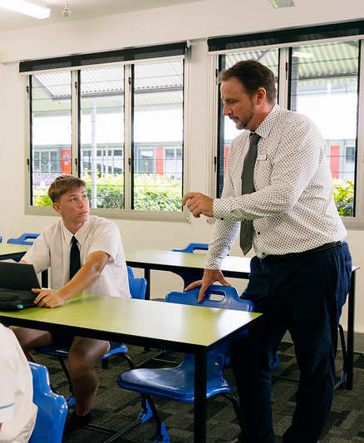
SKILLS ACQUIRED
SIT20122 Certificate II in Tourism
Communication
Customer service
Safe and sustainable work practices
Source and present information
Social and cultural sensitivity
Digital technologies and software applications
Working effectively in business environments

Slide 21

HOW WILL YOU BE ASSESSED?
SIT20122 Certificate II in Tourism
Conducting projects
Completing Tourism-related documents
Personal reflections and quizzes
Knowledge and knowledge extension activities

Slide 22
CAREER PATHWAYS
SIT20122 Certificate II in Tourism
Certificate II in Tourism
Via another RTO
Year 11 and12 Option
Certificate IV / Diploma
Certificate III in Business
Senior Consultant
Retail Travel
Events Coordinator
Tour Wholesale
Tour / Events Manager
Visitor Information Services
Owner Operator
Tour Operations/Tour Guide

Slide 23

BSB30120 Certificate III in Business
BUSINESS

Slide 24
BSB30120 Certificate III in Business (Standalone)
BSB30120 Certificate III in Business (Standalone)
Delivery Format: | 2-Year Format (Packaged as 7-Terms)
Timetable Requirements: | 1-Timetable Line *May be delivered as a 1-Year Program on 2 Timetable Lines - Please consult your Binnacle Program Manager.
Units of Competency: | 13 (6 Core units, 7 Elective units) *plus 2 ‘Optional Additional’ Units
Suitable Year Level(s): | Year 11 and 12
Study Mode: | Combination of classroom and project-based learning, online learning (self-study) and practical work-related experience
Cost (Fee-For-Service): | $395.00 per person
QCE Outcome: | Maximum 8 QCE Credits
This qualification reflects the role of individuals in a variety of Business Services job roles.
The program will be delivered through class-based tasks as well as both simulated and real business environments at the school - involving the delivery of a range of projects and services within the school community.
This program also includes the following:
Student opportunities to design for a new product or service as part of our (non-accredited) Entrepreneurship Project - Binnacle Boss
Students examine business opportunities and participate in an Industry discovery
An excellent work readiness program where students develop a range of essential workplace skills.

Slide 25
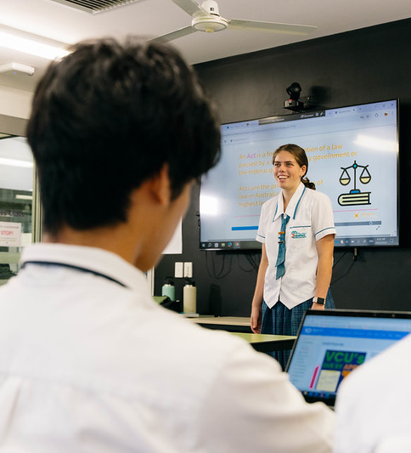
WHAT DO STUDENTS ACHIEVE?
2024 Business & Tourism Course Offerings
BSB30120 Certificate III in Business (Standalone)
BSB30120 Certificate III in Business
(max. 8 QCE Credits)
Successful completion of the Certificate III in Business may contribute towards a student’s Australian Tertiary Admission Rank (ATAR)
*Students eligible for an Australian Tertiary Admission Rank (ATAR) may be able to use their completed Certificate III to contribute towards their ATAR. For more information contact your VET Coordinator.

Slide 26
BSB30120
Certificate III in Business (Standalone)
BSB30120 Certificate III in Business (Standalone)
TERM 1 | TOPICS
 | Introduction to the Business Services Industry Introduction to Entrepreneurship and Business Introduction to Personal Finances
 | PROJECTS
 | Research Business Topics
TERM 5 | TOPICS
 | Personal Finances
 | PROJECTS
 | Personal Budget for the Future
TERM 2 | TOPICS
 | Research Topics and Create a Group Presentation Workplace Health and Safety Sustainable Work Practices
 | PROJECTS
 | Group Presentation WHS Practices at the ‘Go! Regional’ Travel Expo
TERM 6 | TOPICS
 | Work in a Team Critical Thinking Skills
 | PROJECTS
 | Critical Thinking at Go! Travel
COURSE SCHEDULE
TERM 7 PART 1 | TOPICS
 | Producing Simple Documents
 | PROJECTS
 | Binnacle Boss - Business Proposal
TERM 3 | TOPICS
 | Working in a Business Environment Time Management
 | PROJECTS
 | Developing Teamwork in the Workplace
TERM 7 PART 2 (OPTIONAL) | TOPICS
 | Designing and Producing Presentations
 | PROJECTS
 | Deliver a Focus Group Presentation
TERM 4 | TOPICS
 | Inclusive Work Practices Workplace Communication
 | PROJECTS
 | Inclusivity and Communication in the Workplace

Slide 27

SKILLS ACQUIRED
BSB30120 Certificate III in Business (Standalone)
Leadership, innovation and creative thinking
Customer service and teamwork
Inclusivity and effective communication
WHS and sustainability
Financial literacy
Business documentation

Slide 28

HOW WILL YOU BE ASSESSED?
BSB30120 Certificate III in Business (Standalone)
Conducting projects
Completing business-related documents
Personal reflections and quizzes
Knowledge and knowledge extension activities

Slide 29
CAREER PATHWAYS
BSB30120 Certificate III in Business (Standalone)
Certificate III in Business
Via another RTO
Certificate IV / Diploma
e.g. Business, Small Business Management
University Degree
Business Development Manager
Business Owner / Manager
Customer Service Manager
Accountant
Business Advisor
Marketing Manager

Slide 30
BSB30120 Certificate III in Business + BSB20120 Certificate II in Workplace Skills
BUSINESS

Slide 31
BSB30120 Certificate III in Business + BSB20120 Certificate II in Workplace Skills
BSB30120 Certificate III in Business + BSB20120 Certificate II in Workplace Communication
Delivery Format: | 2-Year Format (Packaged as 7-Terms)
Timetable Requirements: | 1-Timetable Line
Units of Competency: | Dual Qualification - 18 Units *plus 2 ‘Optional Additional’ Units
Suitable Year Level(s): | Year 11 and 12
Study Mode: | Combination of classroom and project-based learning, online learning (self-study) and practical work-related experience
Cost (Fee-For-Service): | $395.00 per person (Cert II entry qualification = $345.00 + Cert III Gap Fee = $50.00)
QCE Outcome: | Maximum 8 QCE Credits
This qualification reflects the role of individuals in a variety of Business Services job roles.
The program will be delivered through class-based tasks as well as both simulated and real business environments at the school - involving the delivery of a range of projects and services within the school community.
This program also includes the following:
Student opportunities to design for a new product or service as part of our (non-accredited) Entrepreneurship Project - Binnacle Boss
Students examine business opportunities and participate in an Industry discovery
An excellent work readiness program where students develop a range of essential workplace skills.

Slide 32

WHAT DO STUDENTS ACHIEVE?
2024 Business & Tourism Course Offerings
BSB30120 Certificate III in Business + BSB20120 Certificate II in Workplace Communication
BSB30120 Certificate III in Business plus the entry qualification BSB20120 Certificate II in Workplace Skills (max. 8 QCE Credits)
Successful completion of the Certificate III in Business may contribute towards a student’s Australian Tertiary Admission Rank (ATAR)
*Students eligible for an Australian Tertiary Admission Rank (ATAR) may be able to use their completed Certificate III to contribute towards their ATAR. For more information contact your VET Coordinator.

Slide 33
BSB30120
Certificate III in Business + BSB20120 Certificate II in Workplace Skills
BSB30120 Certificate III in Business + BSB20120 Certificate II in Workplace Communication
TERM 1 | TOPICS
 | Introduction to the Business Services Industry Introduction to Entrepreneurship and Business Introduction to Personal Finances
 | PROJECTS
 | Research Business Topics
TERM 5 | TOPICS
 | Personal Finances
 | PROJECTS
 | Personal Budget for the Future
TERM 2 | TOPICS
 | Research Topics and Create a Group Presentation Workplace Health and Safety Sustainable Work Practices
 | PROJECTS
 | Group Presentation WHS Practices at the ‘Go! Regional’ Travel Expo
TERM 6 | TOPICS
 | Work in a Team Critical Thinking Skills
 | PROJECTS
 | Critical Thinking at Go! Travel
COURSE SCHEDULE
TERM 7 PART 1 | TOPICS
 | Producing Simple Documents
 | PROJECTS
 | Binnacle Boss - Business Proposal
TERM 3 | TOPICS
 | Working in a Business Environment Time Management
 | PROJECTS
 | Developing Teamwork in the Workplace
TERM 7 PART 2 (OPTIONAL) | TOPICS
 | Designing and Producing Presentations
 | PROJECTS
 | Deliver a Focus Group Presentation
TERM 4 | TOPICS
 | Inclusive Work Practices Workplace Communication
 | PROJECTS
 | Inclusivity and Communication in the Workplace

Slide 34
SKILLS ACQUIRED
BSB30120 Certificate III in Business + BSB20120 Certificate II in Workplace Communication
Leadership, innovation and creative thinking
Customer service and teamwork
Inclusivity and effective communication
WHS and sustainability
Financial literacy
Business documentation

Slide 35
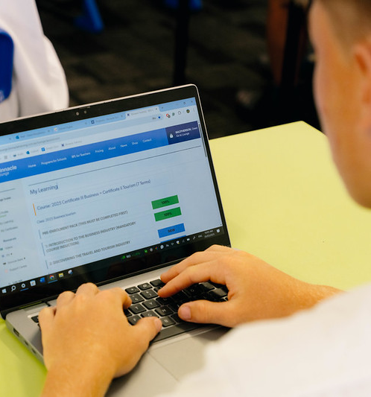
HOW WILL YOU BE ASSESSED?
BSB30120 Certificate III in Business + BSB20120 Certificate II in Workplace Communication
)
Conducting projects
Completing business-related documents
Personal reflections and quizzes
Knowledge and knowledge extension activities

Slide 36
CAREER PATHWAYS
BSB30120 Certificate III in Business + BSB20120 Certificate II in Workplace Communication
Certificate III in Business
Via another RTO
Certificate IV / Diploma
e.g. Business, Small Business Management
University Degree
Business Development Manager
Business Owner / Manager
Customer Service Manager
Accountant
Business Advisor
Marketing Manager

Slide 37

BSB30120 Certificate III in Business & SIT20122 Certificate II in Tourism
BUSINESS & TOURISM

Slide 38
BSB30120 Certificate III in Business + SIT20122 Certificate II in Tourism
BSB30120 Certificate III in Business + SIT20122 Certificate II in Tourism
Delivery Format: | 2-Year Format
Timetable Requirements: | 1-Timetable Line
Units of Competency: | Dual Qualification - 21 Units *plus 2 ‘Optional Additional’ units
Suitable Year Level(s): | Year 11 and 12
Study Mode: | Combination of classroom and project-based learning, online learning (self-study) and practical work-related experience
Cost (Fee-For-Service): | $395.00 per person (Cert II entry qualification = $345.00 + Cert III Gap Fee = $50.00)
QCE Outcome: | Maximum 10 QCE Credits
The program will be delivered through class-based tasks as well as both simulated and real business environments at the school - involving the delivery of a range of projects and services within the school community.
Graduates will be competent in a range of essential business skills including; customer service, personal and team effectiveness, critical thinking, business technology and documents, sourcing and presenting information, workplace health and safety, social and cultural sensitivity and participating in sustainable work practices.
This program also includes the following:
Student opportunities to design for a new product or service as part of our (non-accredited) Entrepreneurship Project - Binnacle Boss
Participation in a Tourism-related Industry Discovery

Slide 39

WHAT DO STUDENTS ACHIEVE?
2024 Business & Tourism Course Offerings
BSB30120 Certificate III in Business + SIT20122 Certificate II in Tourism
BSB30120 Certificate III in Business + SIT20122 Certificate II in Tourism (max. 10 QCE Credits)
Successful completion of the Certificate III in Business may contribute towards a student’s Australian Tertiary Admission Rank (ATAR)
*Students eligible for an Australian Tertiary Admission Rank (ATAR) may be able to use their completed Certificate III to contribute towards their ATAR. For more information contact your VET Coordinator.

Slide 40
BSB30120 Certificate III in Business + SIT20122 Certificate II in Tourism
BSB30120 Certificate III in Business + SIT20122 Certificate II in Tourism
TERM 1 | TOPICS
 | Introduction to the Business Services Industry Introduction to Entrepreneurship and Business Introduction to Tourism
 | PROJECTS
 | Research Business Topics
TERM 5 | TOPICS
 | Inclusive Work Practices Engage in Workplace Communication
 | PROJECTS
 | Inclusivity and Communication in the Workplace
TERM 2 | TOPICS
 | Business Software Applications and Research Workplace Health and Safety Sustainable Work Practices
 | PROJECTS
 | Research Report WHS Practices at the ‘Go! Regional’ Travel Expo
TERM 6 | TOPICS
 | Work in a Team Critical Thinking Skills
 | PROJECTS
 | Critical Thinking at Go! Travel
COURSE SCHEDULE
TERM 3 | TOPICS
 | Source, Use and Present Information on the Tourism and Travel Industry Public Activities and Events
 | PROJECTS
 | Tourism Industry Research Present Information at an Industry Event
TERM 7 PART 1 | TOPICS
 | Designing and Producing Business Documents Producing Simple Documents
 | PROJECTS
 | Binnacle Boss - Business Proposal
TERM 4 | TOPICS
 | Providing Information to Visitors and Customers Interacting with Customers Showing Social and Cultural Sensitivity
 | PROJECTS
 | Go! Travel VIP Information Evening Interact with Customers at the Go! Travel Agency Show Social and Cultural Sensitivity in the Tourism Industry
TERM 7 PART 2 (OPTIONAL) | TOPICS
 | Designing and Producing Presentations
 | PROJECTS
 | Deliver a Focus Group Presentation

Slide 41

SKILLS ACQUIRED
BSB30120 Certificate III in Business + SIT20122 Certificate II in Tourism
Customer service
Source and present information
Personal and teamwork effectiveness
Critical and creative thinking
Inclusivity and effective communication
WHS and sustainability
Business technology and documentation
Source and present information

Slide 42
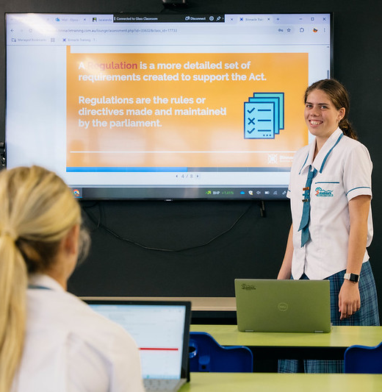
HOW WILL YOU BE ASSESSED?
BSB30120 Certificate III in Business + SIT20122 Certificate II in Tourism
Conducting projects
Completing Tourism and Business-related documents
Personal reflections and quizzes
Knowledge and knowledge extension activities

Slide 43
CAREER PATHWAYS
BSB30120 Certificate III in Business + SIT20122 Certificate II in Tourism
Certificate III in Business + Certificate II in Tourism
Via another RTO
Certificate IV / Diploma
E.g. Business / Tourism
University Degree
Business Development Manager
Business Owner
Customer Service Manager
Business Manager
Tourism Operator
Marketing Manager

Slide 44

Inclusivity and Communication in the Workplace (1-Term)
SHORT COURSE

Slide 45
Inclusivity and Communication in the Workplace (1-Term)
Inclusivity and Communication in the Workplace (1-Term)
Delivery Format: | 1-Term Format
Timetable Requirements: | 1-Timetabled Line
Units of Competency: | 3 Units
Suitable Year Level(s): | Year 10 (or Year 11 or 12)
Study Mode: | Combination of classroom and self directed online learning
Cost (Fee-For-Service): | $75.00 per person
QCE Outcome: | Maximum of 1 QCE Credits 3-Units of Competency towards SIT20122 Certificate II in Tourism
The 'Inclusivity and Communication in the Workplace' Short Course provides students with an opportunity to participate in a practical project which enables students to apply their knowledge and skills in communication and their ability to demonstrate social and cultural awareness. Students host a mini expo in the school environment accessing staff and peers as customers. They will also participate in a customer service role play activity proving they can interact with a customer and handle cross cultural misunderstandings.
This is a perfect short course for preparing senior students for customer service related vocation employment.
*These units are also completed as part of the dual qualification BSB30120 Certificate III in Business + SIT20122 Certificate II in Tourism qualification - Term 4

Slide 46
Inclusivity and Communication in the Workplace (1-Term)
Inclusivity and Communication in the Workplace (1-Term)
TERM 1 | TOPICS
 | Plan and Participate in Workplace Communication Work Effectively with Individual Differences Assess Use of Inclusive Practices Communicate with Customers and Colleagues from Diverse Backgrounds Address Cross-Cultural Misunderstandings
 | PROJECTS
 | Inclusivity and Communication in the Workplace ‘Go! Regional’ Travel Expo Display – Plan, Deliver and Review Show Social and Cultural Sensitivity in the Tourism Industry Interact with Customers Handling Cross-Cultural Misunderstandings (role play)
COURSE SCHEDULE

Slide 47
Technology in the Workplace (1-Term)
SHORT COURSE

Slide 48
Technology in the Workplace (1-Term)
Technology in the Workplace (1-Term)
Delivery Format: | 1-Term Format
Timetable Requirements: | 1-Timetabled Line
Units of Competency: | 2 Units
Suitable Year Level(s): | Year 10 (or Year 11 or 12)
Study Mode: | Combination of classroom and self directed online learning
Cost (Fee-For-Service): | $75.00 per person
QCE Outcome: | 0 QCE Credits
This 2-Unit Short Course provides students with an opportunity to use business software applications and use digital technologies to communicate in the workplace.
Students will plan, draft and finalise presentation designs to present to peers. Students will collaborate in teams using an array of digital communications. These are skills that will assist in many areas of future work and study.
*These units of competency form part of Binnacle Training’s BSB20120 Certificate II in Workplace Skills.

Slide 49
Technology in the Workplace (1-Term)
Technology in the Workplace (1-Term)
TERM 1 | TOPICS
 | Business Software Applications Select and Prepare to Use Technology Input and Process Information Data Finalise and Store Documents Methods of Digital Communication Send and Receive Digital Communications Managing Digital Communications
 | PROJECTS
 | Travel Package Presentation
COURSE SCHEDULE

Slide 50
FNSFLT311 Develop and apply knowledge of personal finances
SHORT COURSE

Slide 51
FNSFLT311 Develop and apply knowledge of personal finances
FNSFLT311 Develop and apply knowledge of personal finances
Delivery Format: | 1-Term Format or Flexible Delivery Options
Timetable Requirements: | 1-Timetabled Line
Units of Competency: | 1 Unit
Suitable Year Level(s): | Year 10 (or Year 11 or 12)
Study Mode: | Combination of classroom and self directed online learning
Cost (Fee-For-Service): | $75.00 per person
QCE Outcome: | 0 QCE Credits
This Short Course is all about students developing their money management skills.
Students are provided with a budget template required to set financial goals and are prompted to input budget data in accordance with a progressive real life scenario. This is a great course for preparing your senior students with Financial Literacy skills and knowledge.
*This unit of competency has been included by Binnacle Training as an ‘imported elective’ in the full qualification - BSB30120 Certificate III in Business.

Slide 52
FNSFLT311 Develop and apply knowledge of personal finances
FNSFLT311 Develop and apply knowledge of personal finances
TERM 1 | TOPICS
 | Develop and Maintain Knowledge of Personal Finance Matters Manage Personal Finances Budgeting, Cash flow and Savings Taxation Matters Superannuation Matters Debt Management Employee Entitlements Insurance Matters Career choice, Education and Skills Create a Personal Budget for the Future
 | PROJECTS
 | Knowledge of Personal Finances Establish your Financial Goals Create a Budget for the Future (Part 1) Create a Budget for the Future (Part 2)
COURSE SCHEDULE

Slide 53
Future Learning Pathways
Direct opportunities upon completion
Year 10
Year 11 & 12
Tertiary Pathway
Career Outcomes
Certificate II | Certificate III | Direct Employment | Certificate IV or University Degree | Future Employment
Tourism Workplace Skills | Business | Administration Assistant, Customer service officer | Certificate IV or Bachelor of Business | Business owner or Manager, Marketing Manager, Accountant

Slide 54
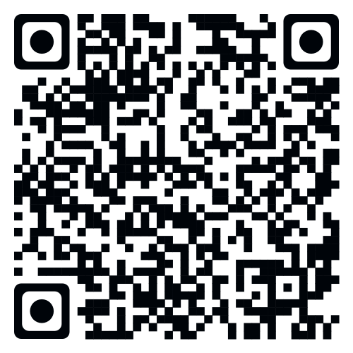
For more information on any of our Binnacle Training Certificate Courses please visit our website (or scan the QR Code):
binnacletraining.com.au/for-schools/programs

Slide 55
Allowing Teachers to Teach
HAVE A QUESTION?
CONTACT US
1300 303 715
admin@binnacletraining.com.au
binnacletraining.com.au

