Slide 1





SPORT, FITNESS & RECREATION
2026 COURSE OFFERINGS
1300 303 715
admin@binnacletraining.com.au
binnacletraining.com.au

Slide 2


THE BINNACLE MISSION
We are leaders in Vocational Education in schools; enabling teachers with high quality certificate programs and support; equipping students with skills to navigate a successful future.

Slide 3

ALLOWING TEACHERS TO TEACH
Our Binnacle Certificate Courses are suitable for students in Years 10-12 across 1, 2 and 3-Year Pathways.
Choose from a variety of Certificate II, Certificate III and Short Course Pathways from a range of study areas including:
Fitness, Sport and Recreation, Business, Tourism and First Aid.
HOW TO GET STARTED:
Please visit our Binnacle Training Website - Programs for Schools for more information on each of our course offerings:
binnacletraining.com.au/for-schools/programs/
1300 303 715
admin@binnacletraining.com.au
binnacletraining.com.au

Slide 4
WHY STUDY WITH BINNACLE TRAINING?
More than 19 Years of Experience Delivering VET in Schools | More than 500 Active Classes State-Wide
5 x National Recognised Certificate Pathways Offerings - Sport, Fitness, First Aid, Business & Tourism PLUS Short Courses | 15,000 Qualifications Issued Approximately Each Year
Over 15 Certificate Programs Offered Each Year | 4 Office Locations - Ipswich, Brisbane, Rockhampton and Townsville
Over 250 Binnacle Partner Secondary Schools | Servicing Secondary Schools across Queensland & ACT
Over 800 Binnacle Program Deliverers | 91% Completion Rate
Binnacle Training are leaders in VET in schools, enabling teachers with quality programs and support; equipping students with skills to navigate a successful future. We are united in our commitment to ‘raising the bar’ with the following highlights showcasing our impressive record:

Slide 5

REAL SKILLS FOR REAL CAREERS
Custom-Built, Student and Teacher Friendly Online Learner Management System (LMS) | Flexible and Student-Friendly Programs Delivered in 1, 2 and 3-Year Formats
Certificate Programs Purpose Built For Secondary Schools (Years 10-12) By Industry and Education Experts | Practical Learning and Project-Based Learning assisting students to acquire key enterprise skills for future world of work
Binnacle Certificate Programs Contribute to a students QCE Credits and ATAR Ranking | Live and Up-To-The-Minute Student Feedback and Progress Reporting - Take the stress out of teacher marking
All Teaching and Assessment Resources Developed for Teachers to save your time and ‘Allow Teachers To Teach’ | World-class Teachers Professional Development Opportunities (Workshops, Webinars, ViSC Conference)
Programs Delivered By Industry-Qualified Trainer and Assessors (Teachers) in a familiar School Environment | Dedicated Teacher and Customer Support Team - Direct Access to Program Management and Admin Support Team

Slide 6

VET IN SCHOOLS
VET in Schools is about gaining practical work-related skills to equip you for the world of work while you are at school.
All VET training embedded in Queensland Curriculum and Assessment Authority (QCAA) subjects and school-based apprenticeships and traineeships count towards a VET qualification as well as the QCE; in effect, allowing students to mix general and vocational education, and make a start on training for a career before they leave school.
As well as readying students for the workforce, VET programs can lead to further study, either in the VET sector (where students can gain credit for their VET certificate) or University.
The number of schools and students involved in VET programs has increased in recent years and most schools now offer some VET options to Senior Secondary Students.
According to the latest data from the National Centre for Vocational Education Research (NCVER), the number of school students undertaking vocational education and training (VET) as part of their senior secondary certificate of education in Queensland increased by 14.4 percent in the 2021 year. Significantly, this is 10.2 percentage points higher than the increase nationally.
NCVER 2022, VET in Schools 2021, NCVER, Adelaide.

Slide 7
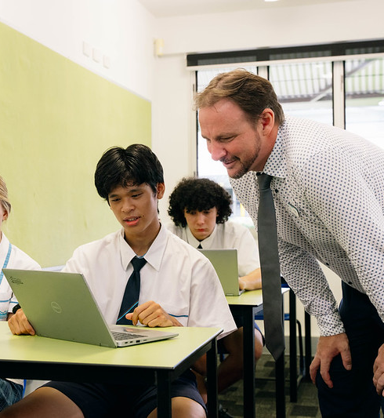
ATAR AND QCE CREDITS
Achievement of a VET Certificate III or above, in combination with results in General Subjects, can contribute to the calculation of a student’s Australian Tertiary Admission Rank (ATAR).
WHAT ARE QCE CREDITS?
VET courses also contribute towards a student’s Queensland Certificate of Education (QCE) which is Queensland’s Senior Secondary Schooling Qualification. To receive a QCE, Queensland students must achieve the set amount of learning which is 20 credits, which can include VET qualifications. Please see our Program-specific sections for more information regarding maximum QCE credits derived from VET qualifications offered by Binnacle Training to Queensland Senior Secondary Students.

Slide 8
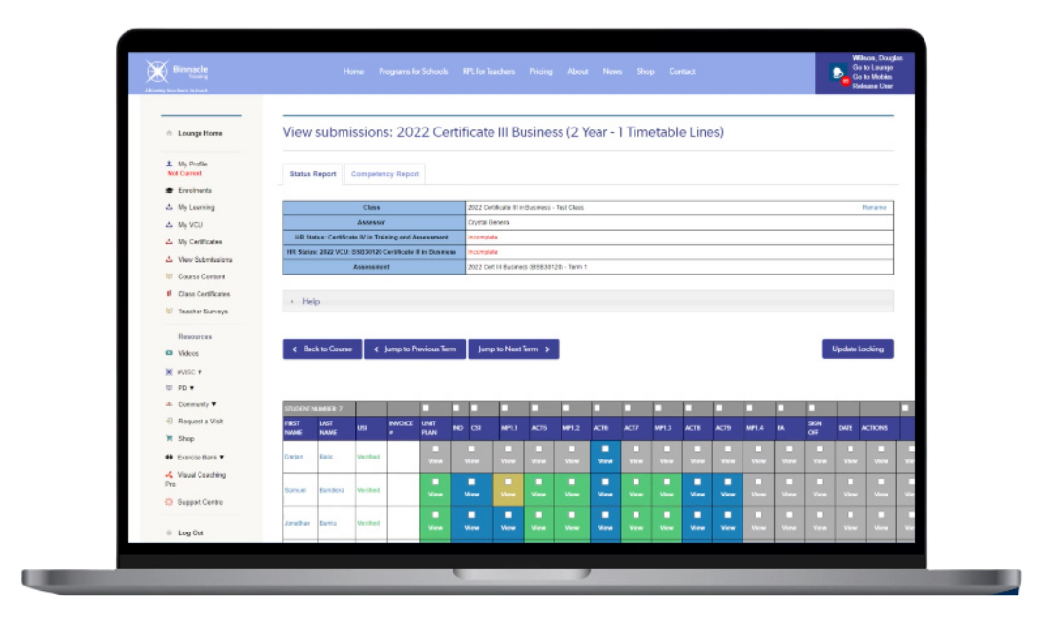
BINNACLE LOUNGE
(LEARNING MANAGEMENT SYSTEM)
The Binnacle Lounge provides:
Real-time status reporting on student outcomes specific to your program
Certificate on completion (a simple download)
All course content in one central location
Interactive online learning including program and tutorial videos
Zero paperwork
Unlimited access - anytime, anywhere
Online Teacher Profile for streamlined management of HR requirements
Delivered mindfully, we are continually evolving and investing in the Binnacle Lounge (and our digital learning resources) to create great experiences for our students and teachers alike.
In 2023, we were proud to celebrate 10 years of the Binnacle Lounge - our very own Learning Management System (LMS) that has been custom-built for Schools, Teachers and Students. With innovation at the forefront, we have enabled the quality facilitation of our programs with a technology solution without peer in VET in Schools.

Slide 9

SIS20122 Certificate II in Sport and Recreation
SPORT, FITNESS & RECREATION

Slide 10

SIS20122 Certificate II in Sport and Recreation
SIS20122 Certificate II in Sport and Recreation
Delivery Format: | 1-Year Format
Timetable Requirements: | 1-Timetable Line
Units of Competency: | 10 (6 Core units, 4 Elective units)
Suitable Year Level(s): | Year 10 (or Year 11 or 12)
Study Mode: | Combination of classroom and project-based learning, online learning (self-study) and practical work-related experience
Cost (Fee-For-Service): | $395.00 per person (+ First Aid $75.00)
QCE Outcome: | Maximum 4 QCE Credits
This qualification reflects the role of individuals who assist with the delivery of sport and recreation activities and who complete a range of customer contact duties.
Students participate in the delivery of a range of sport and recreation activities and programs within the school.
Available with a ‘General’ or ‘Sport Specialty’ Coaching outcome - AFL, NRL, Netball, Rugby Union or Choose Your Own Sport!

Slide 11
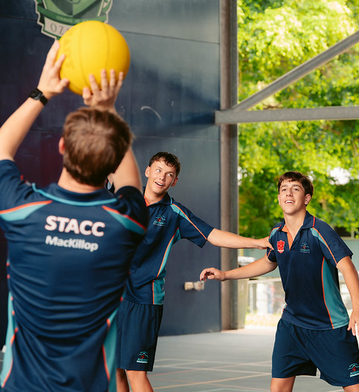

WHAT DO STUDENTS ACHIEVE?
2024 Business & Tourism Course Offerings
SIS20122 Certificate II in Sport and Recreation (Maximum 4 QCE Credits)
Community Coaching - Essential Skills Course (non-accredited), issued by Australian Sports Commission
Direct pathway into SIS30122 Certificate III in Sport, Aquatics and Recreation (or SIS30321 Certificate III in Fitness)
Recommended ‘optional’ additional training - the nationally recognised First Aid competency - HLTAID011 Provide First Aid

Slide 12
SIS20122
Certificate II in Sport and Recreation
SIS20122 Certificate II in Sport and Recreation
TERM 1 | TOPICS
 | Introduction to the Sport, Fitness and Recreation (SFR) Industry Introduction to Coaching Programs, Laws and Legislation
 | PROGRAMS
 | Assist with Delivering Coaching Sessions (Supervisor Delivery) Plan and Deliver Coaching Sessions (Student Delivery)
TERM 3 | TOPICS
 | Working in the SFR Industry - WHS and Provide Quality Service Introduction to Anatomy and Physiology - The Cardiovascular System
 | PROGRAMS
 | Plan and Deliver Group Conditioning Sessions Plan and Deliver a One-on-one Cardio Program
COURSE SCHEDULE
TERM 2 | TOPICS
 | Introduction to Community Programs Introduction to Conditioning Programs
 | PROGRAMS
 | Community SFR Program (Student Delivery) Participate in Conditioning Sessions (Supervisor Delivery)
TERM 4 | TOPICS
 | Anatomy and Physiology - The Musculoskeletal System First Aid Course: HLTAID011 Provide First Aid (Optional Additional Training)
 | PROGRAMS
 | Recreational Group Exercise Program

Slide 13
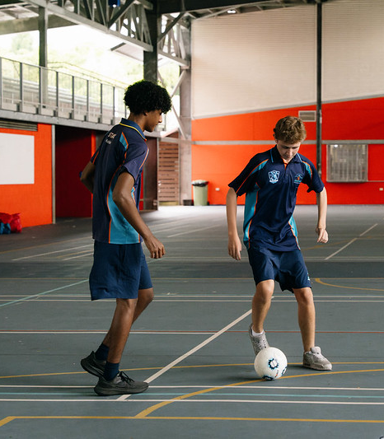
SKILLS ACQUIRED
SIS20122 Certificate II in Sport and Recreation
Officiating games or school competitions
Coaching beginner participants to develop fundamental skills
Effective communication skills
Providing quality service to participants
Using digital technologies in sports environments

Slide 14
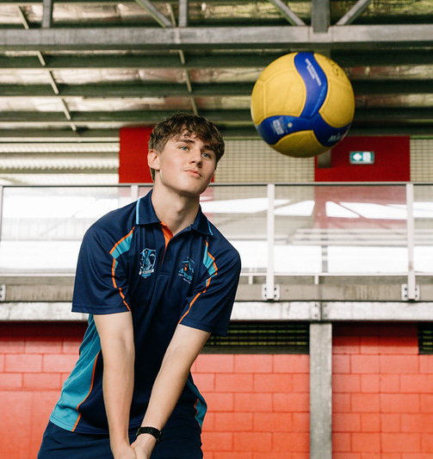
HOW WILL YOU BE ASSESSED?
SIS20122 Certificate II in Sport and Recreation
Planning and conducting programs
Completing sport and recreation-related documents
Personal reflections and quizzes
Knowledge and knowledge extension activities

Slide 15
CAREER PATHWAYS
SIS20122 Certificate II in Sport and Recreation
Certificate II in Sport and Recreation
Club Level Official*
(e.g. Referee – paid position)
Club Level Coach*
Certificate III Pathways
Certificate III in Sport, Aquatics and Recreation
Certificate III in Fitness
Sports Coach
Gym Instructor
Game Development Officer
Group Fitness Instructor
Recreation Officer
* When combined with individual sport’s National Officiating / Coaching Accreditation Scheme
(NOAS/NCAS) technical requirements

Slide 16

SIS20321 Certificate II in Sport Coaching
SPORT, FITNESS & RECREATION

Slide 17
SIS20321 Certificate II in Sport Coaching
SIS20321 Certificate II in Sport Coaching
Delivery Format: | 1-Year Format
Timetable Requirements: | 1-Timetable Line
Units of Competency: | 7 (3 Core units, 4 Elective units)
Suitable Year Level(s): | Year 10 (or Year 11 or 12)
Study Mode: | Combination of classroom and project-based learning, online learning (self-study) and practical work-related experience
Cost (Fee-For-Service): | $395.00 per person (+ First Aid $75.00)
QCE Outcome: | Maximum 4 QCE Credits
This qualification provides a pathway to work in assistant coaching roles working or volunteering at community-based sports clubs and organisations in the Australian sport industry.
Individuals with this qualification use a range of basic coaching skills to engage participants in a specific sport. They work under the supervision of a coach.
Available with a ‘General’ or ‘Sport Specialty’ Coaching outcome - AFL, NRL, Netball, Rugby Union or Choose Your Own Sport!

Slide 18
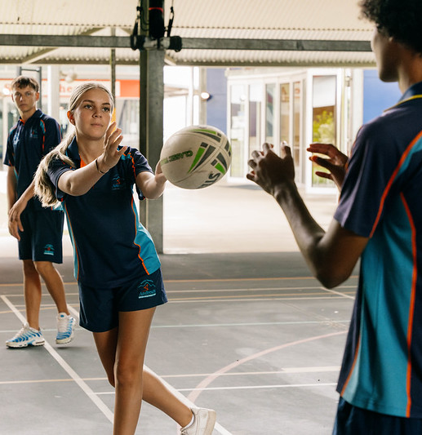
WHAT DO STUDENTS ACHIEVE?
2024 Business & Tourism Course Offerings
SIS20321 Certificate II in Sport Coaching
SIS20321 Certificate II in Sport Coaching (max. 4 QCE Credits)
The nationally recognised First Aid competency - HLTAID011 Provide First Aid
Community Coaching - Essential Skills Course (non-accredited), issued by Australian Sports Commission
Direct pathway into SIS30321 Certificate III in Fitness or SIS30122 Certificate III in Sport, Aquatics and Recreation in Year 11 and 12.

Slide 19
SIS20321
Certificate II in Sport Coaching
SIS20321 Certificate II in Sport Coaching
TERM 1 | TOPICS
 | Introduction to the Sport, Fitness and Recreation (SFR) Industry Introduction to Coaching Programs, Laws and Legislation
 | PROGRAMS
 | Assist with Delivering Coaching Sessions (Supervisor Delivery) Plan and Deliver Coaching Sessions (Student Delivery)
TERM 3 | TOPICS
 | Working in the SFR Industry - Coaching Foundation Level Participants Introduction to Anatomy and Physiology - The Cardiovascular System
 | PROGRAMS
 | Plan and Deliver Group Conditioning Sessions Plan and Deliver a One-on-one Cardio Program
COURSE SCHEDULE
TERM 2 | TOPICS
 | Introduction to Community Programs Introduction to Conditioning Programs
 | PROGRAMS
 | Community SFR Program (Student Delivery) Participate in Conditioning Sessions (Supervisor Delivery)
TERM 4 | TOPICS
 | Sport-specific Coaching Sessions First Aid Course: HLTAID011 Provide First Aid
 | PROGRAMS
 | Sport-specific Coaching Program

Slide 20
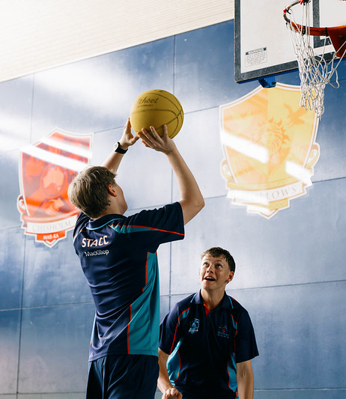
SKILLS ACQUIRED
SIS20321 Certificate II in Sport Coaching
Planning coaching sessions
Coaching foundation level participants
Officiating games and competitions
Work Safely in the Sport, Fitness and Recreation Industry

Slide 21
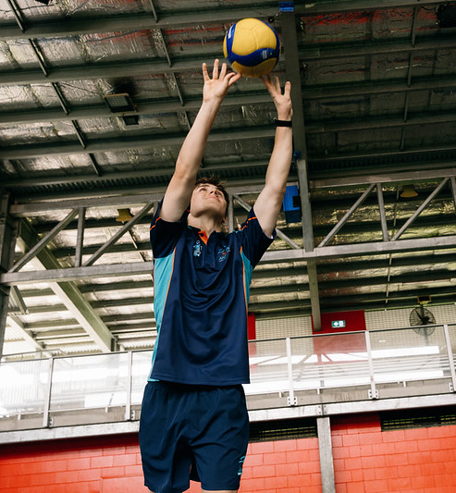
HOW WILL YOU BE ASSESSED?
SIS20321 Certificate II in Sport Coaching
Planning and conducting programs
Completing sport-related documents
Personal reflections and quizzes
Knowledge and knowledge extension activities

Slide 22
CAREER PATHWAYS
SIS20321 Certificate II in Sport Coaching
Certificate II in Sport Coaching
Assistant Coach
Club Level Coach or Official*
Certificate III Pathways
Certificate III in Sport, Aquatics and Recreation
Certificate III in Fitness
Sports Coach
Gym Instructor
Game Development Officer
Group Fitness Instructor
Recreation Officer
* When combined with individual sport’s National Officiating / Coaching Accreditation Scheme
(NOAS/NCAS) technical requirements

Slide 23
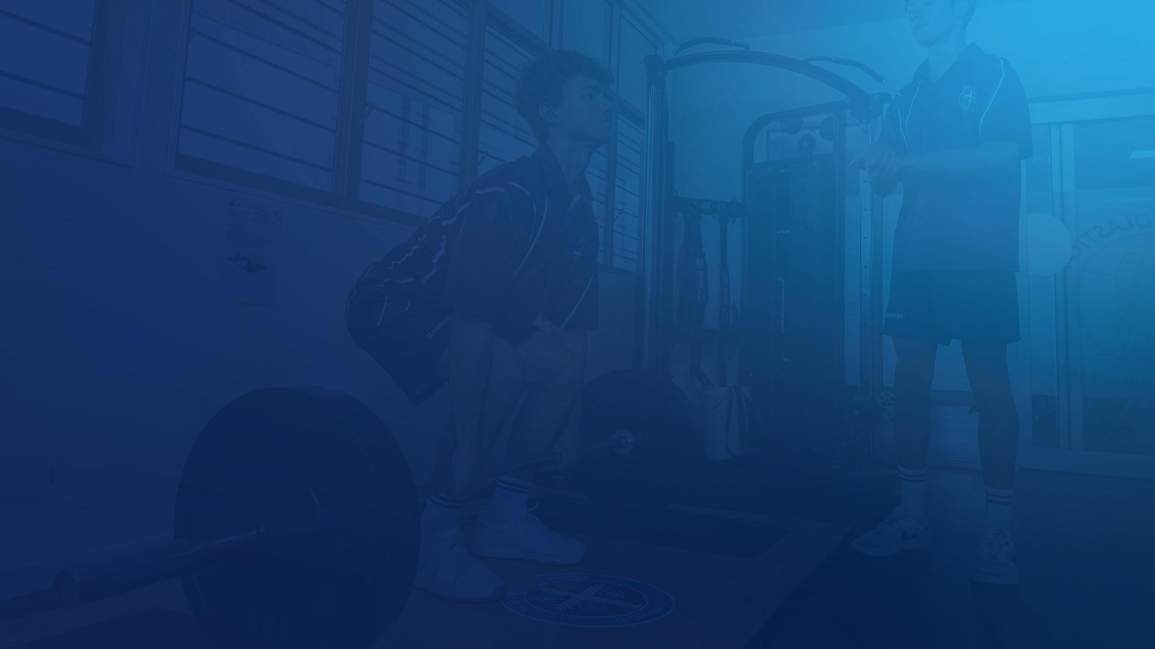
SIS30321 Certificate III in Fitness + SIS20122 Certificate II in Sport and Recreation
SPORT, FITNESS & RECREATION

Slide 24
SIS30321 Certificate III in Fitness + SIS20122 Certificate II in Sport and Recreation
SIS30321 Certificate III in Fitness + SIS20122 Certificate II in Sport and Recreation
Delivery Format: | 2-Year Format
Timetable Requirements: | 1-Timetable Line
Units of Competency: | Standalone Qualification -15 Units Dual Qualification - Additional 4 Units
Suitable Year Level(s): | Year 11 or 12
Study Mode: | Combination of classroom and project-based learning, online learning (self-study) and practical work-related experience
Cost (Fee-For-Service): | $495.00 per person (Cert II entry qualification = $395.00 + Cert III Gap Fee = $100.00) (+ $75.00 First Aid)
QCE Outcome: | Maximum 8 QCE Credits
This qualification provides a pathway to work as a fitness instructor in settings such as fitness facilities, gyms, and leisure and community centres.
Students gain the entry-level skills required of a Fitness Professional (Group Exercise Instructor or Gym Fitness Instructor).
Students facilitate programs within their school community including:
Community fitness programs
Strength and conditioning for athletes and teams
1-on-1 and group fitness sessions with male adults, female adults and older adult clients

Slide 25
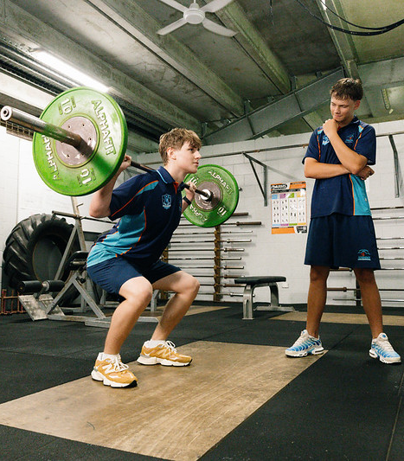
WHAT DO STUDENTS ACHIEVE?
2024 Business & Tourism Course Offerings
SIS30321 Certificate III in Fitness + SIS20122 Certificate II in Sport and Recreation
SIS30321 Certificate III in Fitness (max. 8 QCE Credits)
Entry qualification: SIS20122 Certificate II in Sport and Recreation
The nationally recognised First Aid competency - HLTAID011 Provide First Aid
Community Coaching - Essential Skills Course (non-accredited), issued by Australian Sports Commission
Successful completion of the Certificate III in Fitness may contribute towards a student’s Australian Tertiary Admission Rank (ATAR)
A range of career pathway options including pathway into SIS40221 Certificate IV in Fitness; or SIS50321 Diploma of Sport - These qualifications offered by another RTO

Slide 26
SIS30321 Certificate III in Fitness + SIS20122 Certificate II in Sport and Recreation
SIS30321 Certificate III in Fitness + SIS20122 Certificate II in Sport and Recreation
TERM 1 | TOPICS
 | Introduction to the Sport, Fitness and Recreation (SFR) Industry Introduction to Coaching Programs, Laws and Legislation
 | PROGRAMS
 | Assist with Delivering Coaching Sessions (Supervisor Delivery) Plan and Deliver Coaching Sessions (Student Delivery)
TERM 4 | TOPICS
 | Introduction to Anatomy and Physiology - The Musculoskeletal System First Aid Course: HLTAID011 Provide First Aid
 | PROGRAMS
 | Recreational Group Exercise Program
TERM 5 | TOPICS
 | Anatomy and Physiology - Body Systems and Exercise Health and Nutrition Consultations
 | PROGRAMS
 | One-on-One Gym Program: Adolescent Client Plan and Conduct Sessions (Scenario Clients)
COURSE SCHEDULE
TERM 2 | TOPICS
 | Introduction to Community Programs Introduction to Conditioning Programs
 | PROGRAMS
 | Community SFR Program (Student Delivery) Participate in Conditioning Sessions (Supervisor Delivery)
TERM 6 | TOPICS
 | Screening and Health Assessments Specific Population Clients (including Older Adults)
 | PROGRAMS
 | Fitness Orientation Program: Client Orientation Group Training Program: Plan and Conduct a Group Session
TERM 3 | TOPICS
 | Working in the SFR Industry - WHS and Provide Quality Service Introduction to Anatomy and Physiology - The Cardiovascular System
 | PROGRAMS
 | Plan and Deliver Group Conditioning Sessions Plan and Deliver a One-on-one Cardio Program
TERM 7 | TOPICS
 | N/A - Practical Term
 | PROGRAMS
 | Group Exercise and Gym-based One-on-One Sessions: Female and Male Adults aged 18+; and Older adults aged 55+

Slide 27
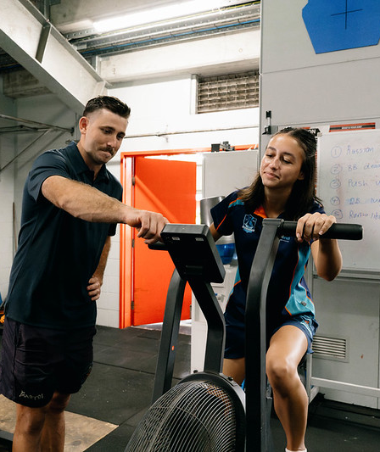
SKILLS ACQUIRED
SIS30321 Certificate III in Fitness + SIS20122 Certificate II in Sport and Recreation
Client screening and health assessment
Planning and instructing fitness programs
Deliver 1-on-1 and group fitness programs
Exercise science and nutrition
Anatomy and physiology

Slide 28
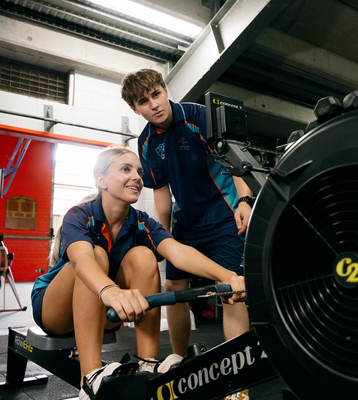
HOW WILL YOU BE ASSESSED?
SIS30321 Certificate III in Fitness + SIS20122 Certificate II in Sport and Recreation
Planning and conducting programs
Completing sport and fitness-related documents
Personal reflections and quizzes
Knowledge and knowledge extension activities
Case studies

Slide 29
CAREER PATHWAYS
SIS30321 Certificate III in Fitness + SIS20122 Certificate II in Sport and Recreation
Certificate III in Fitness
Group Exercise Instructor
Gym Fitness Instructor
University Degree
Certificate IV in Fitness or Diploma of Sport
(These qualifications offered by another RTO)
Exercise Physiologist
Personal Trainer
Teacher - Physical Education
High Performance Coach
Sport Scientist
Sport Development Manager

Slide 30
SIS30321 Certificate III in Fitness + SIS20321 Certificate II in Sport Coaching
SPORT, FITNESS & RECREATION

Slide 31
SIS30321 Certificate III in Fitness + SIS20321 Certificate II in Sport Coaching
SIS30321 Certificate III in Fitness + SIS20321 Certificate II in Sport Coaching
Delivery Format: | 2-Year Format
Timetable Requirements: | 1-Timetable Line
Units of Competency: | Dual Qualification -18 Units
Suitable Year Level(s): | Year 11 or 12
Study Mode: | Combination of classroom and project-based learning, online learning (self-study) and practical work-related experience
Cost (Fee-For-Service): | $495.00 per person (Cert II entry qualification = $395.00 + Cert III Gap Fee = $100.00) (+ $75.00 First Aid)
QCE Outcome: | Maximum 8 QCE Credits
This qualification provides a pathway to work as a fitness instructor in settings such as fitness facilities, gyms, and leisure and community centres.
Students gain the entry-level skills required of a Fitness Professional (Group Exercise Instructor or Gym Fitness Instructor).
Students facilitate programs within their school community including:
Community fitness programs
Strength and conditioning for athletes and teams
1-on-1 and group fitness sessions with male adults, female adults and older adult clients

Slide 32
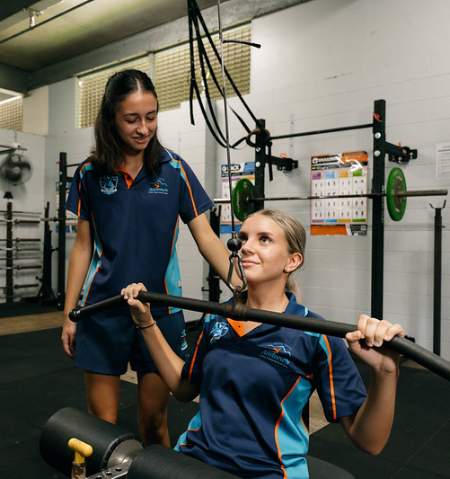
WHAT DO STUDENTS ACHIEVE?
2024 Business & Tourism Course Offerings
SIS30321 Certificate III in Fitness + SIS20321 Certificate II in Sport Coaching
SIS30321 Certificate III in Fitness (max. 8 QCE Credits)
Entry qualification: SIS20321 Certificate II in Sport Coaching
The nationally recognised First Aid competency - HLTAID011 Provide First Aid
Community Coaching - Essential Skills Course (non-accredited), issued by Australian Sports Commission
Successful completion of the Certificate III in Fitness may contribute towards a student’s Australian Tertiary Admission Rank (ATAR)
A range of career pathway options including pathway into SIS40221 Certificate IV in Fitness; or SIS50321 Diploma of Sport - These qualifications offered by another RTO

Slide 33
SIS30321 Certificate III in Fitness + SIS20321 Certificate II in Sport Coaching
SIS30321 Certificate III in Fitness + SIS20321 Certificate II in Sport Coaching
TERM 1 | TOPICS
 | Introduction to the Sport, Fitness and Recreation (SFR) Industry Introduction to Coaching Programs, Laws and Legislation
 | PROGRAMS
 | Assist with Delivering Coaching Sessions (Supervisor Delivery) Plan and Deliver Coaching Sessions (Student Delivery)
TERM 4 | TOPICS
 | Sport-Specific Coaching Sessions First Aid Course: HLTAID011 Provide First Aid
 | PROGRAMS
 | Sport-Specific Coaching Program
TERM 5 | TOPICS
 | Anatomy and Physiology - Body Systems and Exercise Health and Nutrition Consultations
 | PROGRAMS
 | One-on-One Gym Program: Adolescent Client Plan and Conduct Sessions (Scenario Clients)
COURSE SCHEDULE
TERM 2 | TOPICS
 | Introduction to Community Programs Introduction to Conditioning Programs
 | PROGRAMS
 | Community SFR Program (Student Delivery) Participate in Conditioning Sessions (Supervisor Delivery)
TERM 6 | TOPICS
 | Screening and Health Assessments Specific Population Clients (including Older Adults)
 | PROGRAMS
 | Fitness Orientation Program: Client Orientation Group Training Program: Plan and Conduct a Group Session
TERM 3 | TOPICS
 | Working in the SFR Industry – Coaching Foundation Level Participants Introduction to Anatomy and Physiology - The Cardiovascular System
 | PROGRAMS
 | Plan and Deliver Group Conditioning Sessions Plan and Deliver a One-on-one Cardio Program
TERM 7 | TOPICS
 | N/A - Practical Term
 | PROGRAMS
 | Group Exercise and Gym-based One-on-One Sessions: Female and Male Adults aged 18+; and Older adults aged 55+

Slide 34
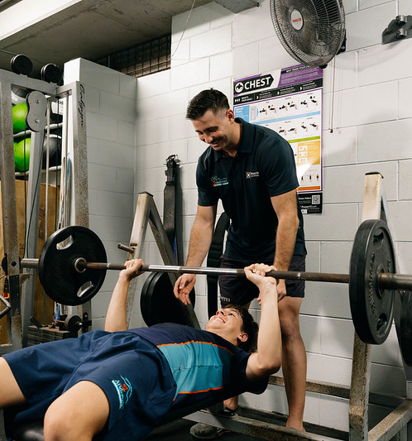
SKILLS ACQUIRED
SIS30321 Certificate III in Fitness + SIS20321 Certificate II in Sport Coaching
Client screening and health assessment
Planning and instructing fitness programs
Deliver 1-on-1 and group fitness programs
Exercise science and nutrition
Anatomy and physiology

Slide 35
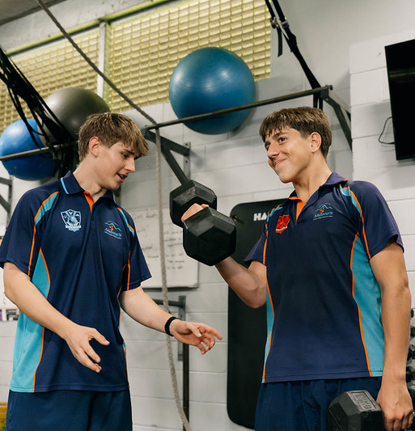
HOW WILL YOU BE ASSESSED?
SIS30321 Certificate III in Fitness + SIS20321 Certificate II in Sport Coaching
Planning and conducting programs
Completing sport and fitness-related documents
Personal reflections and quizzes
Knowledge and knowledge extension activities
Case studies

Slide 36
CAREER PATHWAYS
SIS30321 Certificate III in Fitness + SIS20321 Certificate II in Sport Coaching
Certificate III in Fitness
Group Exercise Instructor
Gym Fitness Instructor
University Degree
Certificate IV in Fitness or Diploma of Sport
(These qualifications offered by another RTO)
Exercise Physiologist
Personal Trainer
Teacher - Physical Education
High Performance Coach
Sport Scientist
Sport Development Manager

Slide 37

SIS30321 Certificate III
in Fitness
SPORT, FITNESS & RECREATION

Slide 38
SIS30321 Certificate III
in Fitness
SIS30321 Certificate III in Fitness
Delivery Format: | 2-Year Format
Timetable Requirements: | 1-Timetable Line
Units of Competency: | 15 Units
Suitable Year Level(s): | Year 11 or 12
Study Mode: | Combination of classroom and project-based learning, online learning (self-study) and practical work-related experience
Cost (Fee-For-Service): | $495.00 per person (+ $75.00 First Aid)
QCE Outcome: | Maximum 8 QCE Credits
This qualification provides a pathway to work as a fitness instructor in settings such as fitness facilities, gyms, and leisure and community centres.
Students gain the entry-level skills required of a Fitness Professional (Group Exercise Instructor or Gym Fitness Instructor).
Students facilitate programs within their school community including:
Community fitness programs
Strength and conditioning for athletes and teams
1-on-1 and group fitness sessions with male adults, female adults and older adult clients

Slide 39
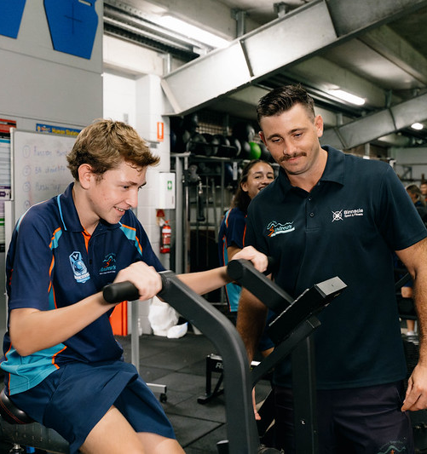
WHAT DO STUDENTS ACHIEVE?
2024 Business & Tourism Course Offerings
SIS30321 Certificate III in Fitness
SIS30321 Certificate III in Fitness (max. 8 QCE Credits)
The nationally recognised First Aid competency - HLTAID011 Provide First Aid
Community Coaching - Essential Skills Course (non-accredited), issued by Australian Sports Commission
A range of career pathway options including pathway into SIS40221 Certificate IV in Fitness; or SIS50321 Diploma of Sport - These qualifications offered by another RTO.
Successful completion of the Certificate III in Fitness may contribute towards a student’s Australian Tertiary Admission Rank (ATAR)

Slide 40
SIS30321 Certificate III in Fitness
SIS30321 Certificate III in Fitness
TERM 1 | TOPICS
 | Introduction to the Sport, Fitness and Recreation (SFR) Industry Introduction to Coaching Programs, Laws and Legislation
 | PROGRAMS
 | Assist with Delivering Coaching Sessions (Supervisor Delivery) Plan and Deliver Coaching Sessions (Student Delivery)
TERM 4 | TOPICS
 | Introduction to Anatomy and Physiology - The Musculoskeletal System First Aid Course: HLTAID011 Provide First Aid
 | PROGRAMS
 | Recreational Group Exercise Program
TERM 5 | TOPICS
 | Anatomy and Physiology - Body Systems and Exercise Health and Nutrition Consultations
 | PROGRAMS
 | One-on-One Gym Program: Adolescent Client Plan and Conduct Sessions (Scenario Clients)
COURSE SCHEDULE
TERM 2 | TOPICS
 | Introduction to Community Programs Introduction to Conditioning Programs
 | PROGRAMS
 | Community SFR Program (Student Delivery) Participate in Conditioning Sessions (Supervisor Delivery)
TERM 6 | TOPICS
 | Screening and Health Assessments Specific Population Clients (including Older Adults)
 | PROGRAMS
 | Fitness Orientation Program: Client Orientation Group Training Program: Plan and Conduct a Group Session
TERM 3 | TOPICS
 | Working in the SFR Industry - WHS and Provide Quality Service Introduction to Anatomy and Physiology - The Cardiovascular System
 | PROGRAMS
 | Plan and Deliver Group Conditioning Sessions Plan and Deliver a One-on-one Cardio Program
TERM 7 | TOPICS
 | N/A - Practical Term
 | PROGRAMS
 | Group Exercise and Gym-based One-on-One Sessions: Female and Male Adults aged 18+; and Older adults aged 55+

Slide 41
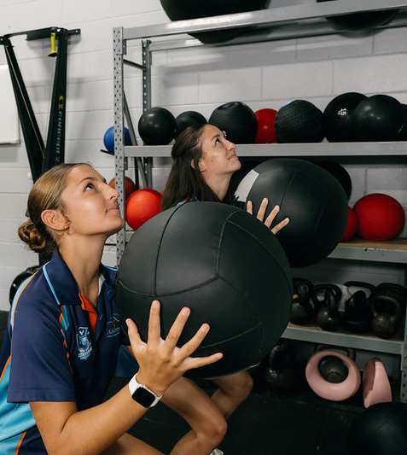
SKILLS ACQUIRED
SIS30321 Certificate III in Fitness
Client screening and health assessment
Planning and instructing fitness programs
Deliver 1-on-1 and group fitness programs
Exercise science and nutrition
Anatomy and physiology

Slide 42
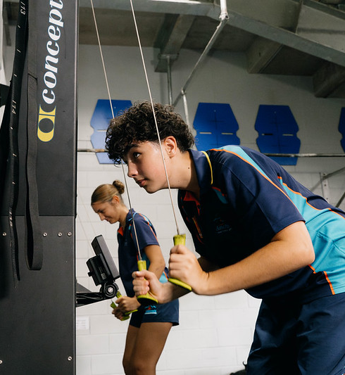
HOW WILL YOU BE ASSESSED?
SIS30321 Certificate III in Fitness
Planning and conducting fitness programs
Completing fitness-related documents
Personal reflections and quizzes
Knowledge and knowledge extension activities
Case studies

Slide 43
CAREER PATHWAYS
SIS30321 Certificate III in Fitness
Certificate III in Fitness
Group Exercise Instructor
Gym Fitness Instructor
University Degree
Certificate IV in Fitness or Diploma of Sport
(These qualifications offered by another RTO)
Exercise Physiologist
Personal Trainer
Teacher - Physical Education
High Performance Coach
Sport Scientist
Sport Development Manager

Slide 44

SIS30122 Certificate III in Sport, Aquatics and Recreation + SIS20122 Certificate II in Sport and Recreation
SPORT, FITNESS & RECREATION

Slide 45
SIS30122 Certificate III in Sport, Aquatics and Recreation + SIS20122 Certificate II in Sport and Recreation
SIS30122 Certificate III in Sport, Aquatics and Recreation + SIS20122 Certificate II in Sport and Recreation
Delivery Format: | 2-Year Format
Timetable Requirements: | 1-Timetable Line
Units of Competency: | Standalone Qualification -15 Units Dual Qualification - Additional 3 Units
Suitable Year Level(s): | Year 11 or 12
Study Mode: | Combination of classroom and project-based learning, online learning (self-study) and practical work-related experience
Cost (Fee-For-Service): | $495.00 per person (Cert II entry qualification = $395.00 + Cert III Gap Fee = $100.00) (+ First Aid $75.00)
QCE Outcome: | Maximum 6 QCE Credits (Standalone Qualification) or 7 QCE Credits (Dual Qualification). Completing the Term 7 Add-on as well can result in a maximum 8 QCE Credits
This qualification reflects the multiskilled role of individuals in operational and customer support positions in the sport or community recreation industry.
Students assist with facilitation of sport and recreation programs within their school community including:
Officiating games
Conducting coaching sessions
Community sport, fitness and recreation programs
Using digital technologies in sports environments
Available with a ‘General’ or ‘Sport Specialty’ Coaching and Officiating outcome - AFL, NRL, Netball, Rugby Union or Choose Your Own Sport!

Slide 46
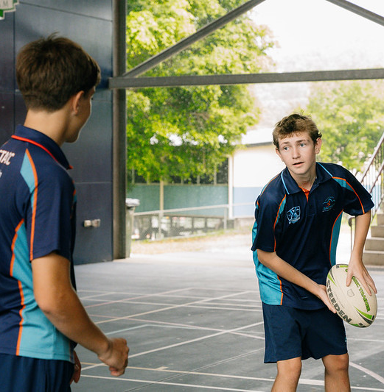
WHAT DO STUDENTS ACHIEVE?
2024 Business & Tourism Course Offerings
SIS30122 Certificate III in Sport, Aquatics and Recreation + SIS20122 Certificate II in Sport and Recreation
SIS30122 Certificate III in Sport, Aquatics and Recreation (max. 6 QCE Credits). Completing the ‘Term 7 Add-On’ as well can result in a maximum 8 QCE Credits
Entry qualification: SIS20122 Certificate II in Sport and Recreation (only in Dual Qualification)
The nationally recognised First Aid competency - HLTAID011 Provide First Aid
Community Coaching - Essential Skills Course (non-accredited), issued by Australian Sports Commission
A range of career pathway options including Club Level Official and/or Coach
Successful completion of the Certificate III in Sport, Aquatics and Recreation may contribute towards a student’s Australian Tertiary Admission Rank (ATAR)

Slide 47
SIS30122 Certificate III in Sport, Aquatics and Recreation + SIS20122 Certificate II in Sport and Recreation
TERM 1 | TOPICS
 | Introduction to the Sport, Fitness and Recreation (SFR) Industry Introduction to Coaching Programs, Laws and Legislation
 | PROGRAMS
 | Assist with Delivering Coaching Sessions (Supervisor Delivery) Plan and Deliver Coaching Sessions (Student Delivery)
SIS30122 Certificate III in Sport, Aquatics and Recreation
+ SIS20122 Certificate II in Sport and Recreation
TERM 5 | TOPICS
 | Deliver Outdoor Recreation Sessions
 | PROGRAMS
 | Deliver Outdoor Recreation Sessions
TERM 6 | TOPICS
 | Sport-Specific Coaching Program Developing Self-Awareness
 | PROGRAMS
 | Plan and Deliver a Sport Development Program Plan and Deliver a Community Recreation Session for Children
TERM 2 | TOPICS
 | Introduction to Community Programs Introduction to Conditioning Programs
 | PROGRAMS
 | Community SFR Program (Student Delivery) Participate in Conditioning Sessions (Supervisor Delivery)
COURSE SCHEDULE
TERM 7 (Part 1) | TOPICS
 | Round-Robin Tournaments Working Effectively with Others Responding to Interpersonal Conflict
 | PROGRAMS
 | Plan and Deliver a Round-Robin Tournament Role-Play Conflict Scenarios
TERM 3 | TOPICS
 | Working in the SFR Industry - WHS and Provide Quality Service Introduction to Anatomy and Physiology - The Cardiovascular System
 | PROGRAMS
 | Plan and Deliver Group Conditioning Sessions Plan and Deliver a One-on-one Cardio Program
TERM 7 (PART 2) OPTIONAL ADD-ON: 4 x Units of Competency | TOPICS
 | Officiating Sports
 | PROGRAMS
 | Officiate Modified Games
TERM 4 | TOPICS
 | Recreational Exercise in the SFR Industry First Aid Course: HLTAID011 Provide First Aid
 | PROGRAMS
 | Recreational Program (Teacher Facilitated): Assist with Recreational Activity (Bootcamp)

Slide 48
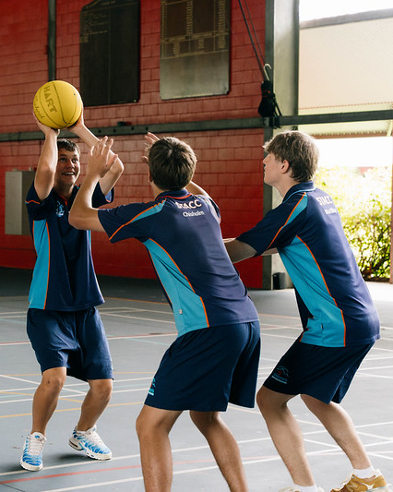
SKILLS ACQUIRED
SIS30122 Certificate III in Sport, Aquatics and Recreation + SIS20122 Certificate II in Sport and Recreation
Planning and conducting sport and recreation programs and competitions
Exercise science and nutrition
Anatomy and physiology
Officiating games or school competitions
Coaching beginner participants to develop fundamental skills
Using digital technologies in sports environments

Slide 49
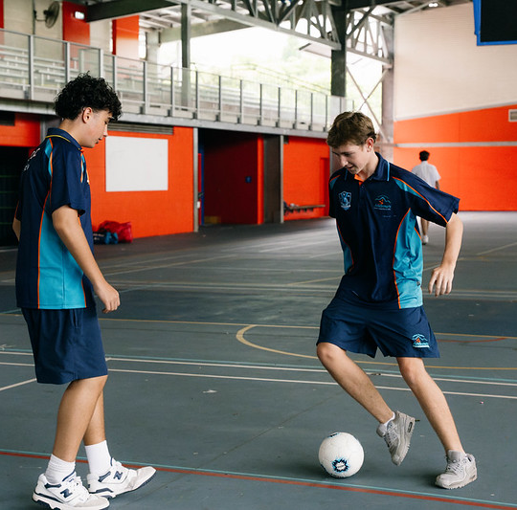
HOW WILL YOU BE ASSESSED?
SIS30122 Certificate III in Sport, Aquatics and Recreation + SIS20122 Certificate II in Sport and Recreation
Planning and conducting programs
Completing sport and recreation-related documents
Personal reflections and quizzes
Knowledge and knowledge extension activities

Slide 50
CAREER PATHWAYS
SIS30122 Certificate III in Sport, Aquatics and Recreation + SIS20122 Certificate II in Sport and Recreation
Certificate III in Sport, Aquatics and Recreation
Club Level Official*
(e.g. Referee – paid position)
Club Level Coach*
University Degree
Certificate IV in Fitness or Diploma of Sport
(e.g. Fitness / Sport and Recreation)
Teacher – Physical Education
Personal Trainer /
Fitness Coach
Sport Scientist
Game Development Officer
Exercise Physiologist
* When combined with individual sport’s National Officiating / Coaching Accreditation Scheme
(NOAS/NCAS) technical requirements

Slide 51
SIS30521 Certificate III in Sport Coaching + SIS20321 Certificate II in Sport Coaching
SPORT, FITNESS & RECREATION

Slide 52
SIS30521 Certificate III in Sport Coaching + SIS20321 Certificate II in Sport Coaching
SIS30521 Certificate III in Sport Coaching + SIS20321 Certificate II in Sport Coaching
Delivery Format: | 2-Year Format
Timetable Requirements: | 1-Timetable Line
Units of Competency: | Dual Qualification - 14 Units
Suitable Year Level(s): | Year 11 or 12
Study Mode: | Combination of classroom and project-based learning, online learning (self-study) and practical work-related experience
Cost (Fee-For-Service): | $495.00 per person (Cert II entry qualification = $395.00 + Cert III Gap Fee = $100.00) (+ First Aid $75.00)
QCE Outcome: | Maximum 8 QCE Credits
This qualification reflects the role of individuals who apply the skills and knowledge to coach participants up to an intermediate level in a specific sport.
Students assist with facilitation of sport and recreation programs within their school community including:
Officiating games
Conducting individual and team coaching sessions
Delivering conditioning sessions
Available with a ‘General’ or ‘Sport Specialty’ Coaching and Officiating outcome - AFL, NRL, Netball, Rugby Union or Choose Your Own Sport!

Slide 53
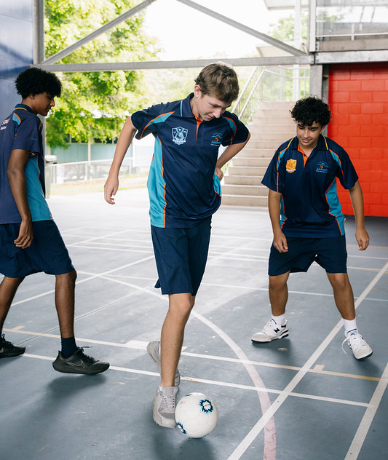
WHAT DO STUDENTS ACHIEVE?
2024 Business & Tourism Course Offerings
SIS30521 Certificate III in Sport Coaching + SIS20321 Certificate II in Sport Coaching
SIS30521 Certificate III in Sport Coaching plus the entry qualification: SIS20321 Certificate II in Sport Coaching (8 QCE Credits maximum)
The nationally recognised First Aid competency - HLTAID011 Provide First Aid
Community Coaching - Essential Skills Course (non-accredited), issued by Australian Sports Commission
A range of career pathway options including Club Level Official and/or Coach
Successful completion of the Certificate III in Sport Coaching may contribute towards a student’s Australian Tertiary Admission Rank (ATAR)

Slide 54
SIS30521 Certificate III in Sport Coaching + SIS20321Certificate II in Sport Coaching
SIS30521 Certificate III in Sport Coaching + SIS20321 Certificate II in Sport Coaching
TERM 1 | TOPICS
 | Introduction to the Sport, Fitness and Recreation (SFR) Industry Introduction to Coaching Programs, Laws and Legislation
 | PROGRAMS
 | Assist with Delivering Coaching Sessions (Supervisor Delivery) Plan and Deliver Coaching Sessions (Student Delivery)
TERM 4 | TOPICS
 | Sport-Specific Coaching Sessions First Aid Course: HLTAID011 Provide First Aid
 | PROGRAMS
 | Sport-Specific Coaching Program
COURSE SCHEDULE
TERM 5 | TOPICS
 | Risk Management Professional Development for Coaches
 | PROGRAMS
 | One-on-One Coaching Program Conduct Risk Assessment for Coaching Program
TERM 2 | TOPICS
 | Introduction to Community Programs Introduction to Conditioning Programs
 | PROGRAMS
 | Community SFR Program (Student Delivery) Participate in Conditioning Sessions (Supervisor Delivery)
TERM 6 | TOPICS
 | Coaching Intermediate Level Participants Meet Participant Coaching Needs
 | PROGRAMS
 | Coaching an Intermediate Level Team
TERM 3 | TOPICS
 | Working in the SFR Industry - Provide Quality Service Introduction to Anatomy and Physiology - The Cardiovascular System
 | PROGRAMS
 | Plan and Deliver Group Conditioning Sessions Plan and Deliver a One-on-one Cardio Program
TERM 7 | TOPICS
 | N/A – Practical Term
 | PROGRAMS
 | Round-Robin Tournament

Slide 55
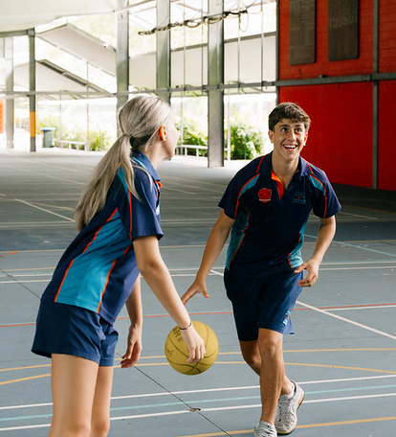
SKILLS ACQUIRED
SIS30521 Certificate III in Sport Coaching + SIS20321 Certificate II in Sport Coaching
Planning and conducting sport coaching programs and competitions
Anatomy and physiology
Officiating games or school competitions
Coaching beginner and intermediate participants to develop skills
Effective communication skills
Managing risks in an SFR environment

Slide 56
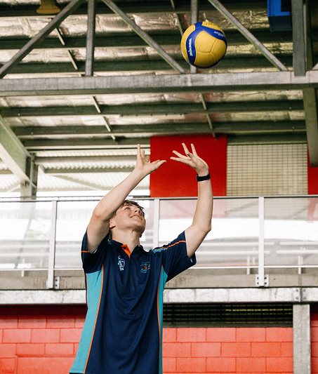
HOW WILL YOU BE ASSESSED?
SIS30521 Certificate III in Sport Coaching + SIS20321 Certificate II in Sport Coaching
Planning and conducting programs
Completing sport and coaching-related documents
Personal reflections and quizzes
Knowledge and knowledge extension activities

Slide 57
CAREER PATHWAYS
SIS30521 Certificate III in Sport Coaching + SIS20321 Certificate II in Sport Coaching
Certificate III in Sport Coaching
Club Level Official*
(e.g. Referee – paid position)
Club Level Coach*
University Degree
Certificate IV in Fitness or Diploma of Sport
(e.g. Fitness / Sport and Recreation)
Teacher – Physical Education
Personal Trainer /
Fitness Coach
Sport Scientist
Game Development Officer
Exercise Physiologist
* When combined with individual sport’s National Officiating / Coaching Accreditation Scheme
(NOAS/NCAS) technical requirements

Slide 58

Introduction to Sport and Fitness (1-Term & 2-Term Options)
SHORT COURSE

Slide 59
Introduction to Sport, Fitness & Recreation
(2-Term Format)
Introduction to Sport, Fitness and Recreation - Short Course
Delivery Format: | 2-Term Format
Timetable Requirements: | 1-Timetable Line
Units of Competency: | 4 Units
Suitable Year Level(s): | Year 10 (or Year 11 or 12)
Study Mode: | Combination of classroom and project-based learning, online learning (self-study) and practical work-related experience
Cost (Fee-For-Service): | $100.00 per person
QCE Outcome: | Maximum 2 QCE Credits. 4-Units of Competency towards SIS30321 Certificate III in Fitness
This 4-Unit Short Course is a great Year 10 option for HPE or Sports Academy Programs prior to commencing Certificate III course.
Topics of study include sport coaching, personal development, self-awareness, healthy eating and fitness programs.

Slide 60
Introduction to Sport (1-Term) & Introduction to Fitness (1-Term)
Introduction to Sport, Fitness and Recreation - Short Course
Delivery Format: | 1-Term Format
Timetable Requirements: | 1-Timetable Line
Units of Competency: | 2 Units
Suitable Year Level(s): | Year 10 (or Year 11 or 12)
Study Mode: | Combination of classroom and project-based learning, online learning (self-study) and practical work-related experience
Cost (Fee-For-Service): | $75.00 per person
QCE Outcome: | 0 QCE Credits
These 1-Term Short Courses are the perfect fit for schools which are looking for a 1-Term option in their Year 10 HPE or Sports Academy Programs.
Introduction to Sport and Recreation (2-Unit Short Course) topics include:
Sport Coaching and Self-Awareness.
Introduction to Fitness (2-Unit Short Course) topics include:
Fitness Programs and Body Systems.

Slide 61
Sports Emergency Management + First Aid
(4-Unit Short Course)
SHORT COURSE

Slide 62
Sports Emergency Management + First Aid
(4-Unit Short Course)
Sports Emergency Management + First Aid - 4 Unit Short Course
Delivery Format: | 1-Term Format
Timetable Requirements: | 1-Timetable Line
Units of Competency: | 4 Units
Suitable Year Level(s): | Year 10 (or Year 11 or 12)
Study Mode: | Combination of classroom and project-based learning, online learning (self-study) and practical work-related experience
Cost (Fee-For-Service): | $100.00 per person
QCE Outcome: | Maximum 2 QCE Credits. 4-Units of Competency towards SIS20321 Certificate II in Sport Coaching
This 4-Unit Short Course is a great Year 10 option for HPE or Sports Academy Programs.
Topics of study include emergency management, risk awareness, responding to emergencies, working safely, first aid and cardiopulmonary resuscitation.

Slide 63

HLTAID011
Provide First Aid
FIRST AID & CPR SHORT COURSES

Slide 64

HLTAID011
Provide First Aid
HLTAID011 Provide First Aid
Delivery Format: | This course has the following course duration options: School Term Delivery: 12 x 70 min lessons Two-Day Delivery: 10 hours (2 x 5-hour days). One-Day Delivery: The practical can be completed in approximately 5 hours. All knowledge assessments must be completed by participants prior to this one-day delivery.
Suitable Year Level(s): | Year 9, 10, 11 and 12
Study Mode: | Combination of Face-to-face and online
Cost (Fee-For-Service): | $75.00 per person
QCE Outcome: | 0 QCE Credits
Students learn to confidently manage emergency situations and provide first aid care to a casualty. It is suitable for both people in a workplace and members of the public who want first aid training.
Binnacle Training recommends, in line with Australian Resuscitation Council guidelines, that First Aid skills are recertified every 3 years, and CPR skills are recertified every 12 months.
Participants are required to undertake practical training and assessment at floor level which includes demonstrating CPR on a manikin for at least two minutes.
Participants must attend 100% of this first aid training and will also require suitable language, literacy and numeracy skills to complete the course.

Slide 65

HLTAID009
Provide cardiopulmonary resuscitation
FIRST AID & CPR SHORT COURSES

Slide 66
HLTAID009 Provide cardiopulmonary resuscitation
HLTAID009 Provide cardiopulmonary resuscitation
Delivery Format: | This course has the following course duration options: School Term Delivery: 4 x 70 min lessons One-Day Delivery: Approximately 5 hours. Half-Day Delivery: The practical may be completed in approximately 3 hours. All knowledge assessments must be completed by participants prior to this half-day delivery.
Suitable Year Level(s): | Year 9, 10, 11 and 12
Study Mode: | Combination of Face-to-face and online
Cost (Fee-For-Service): | $50.00 per person
QCE Outcome: | 0 QCE Credits
Students learn the skills to recognise and manage a casualty who is unconscious and not breathing. CPR is a lifesaving technique which can sustain life until an ambulance arrives.
Binnacle Training recommends, in line with Australian Resuscitation Council guidelines, that CPR skills are recertified every 12 months.
Participants are required to undertake practical training and assessment at floor level which includes demonstrating CPR on a manikin for at least two minutes.
Participants must attend 100% of this first aid training and will also require suitable language, literacy and numeracy skills to complete the course.

Slide 67
Future Learning Pathways
Direct opportunities upon completion
Year 10
Year 11 & 12
Tertiary Pathway
Career Outcomes
Certificate II | Certificate III | Direct Employment | Certificate IV or University Degree | Future Employment
Sport & Recreation Sports Coaching | Sport, Aquatics & Recreation Sport Coaching | Community Sport Coach or Official | Certificate IV in Sport & Recreation or Bachelor of Sport Development | Sport Program Manager, Development Officer, Health Promotion Officer
SHORT COURSES Introduction to Sport Introduction to Fitness Sports Emergency Management | Fitness | Fitness instructor, Gym Supervisor, Group Trainer | Certificate IV in Fitness and/or Bachelor of Exercise Science | Exercise Physiologist, Strength & Conditioning Coach, Exercise Specialist for community and sport organisations

Slide 68
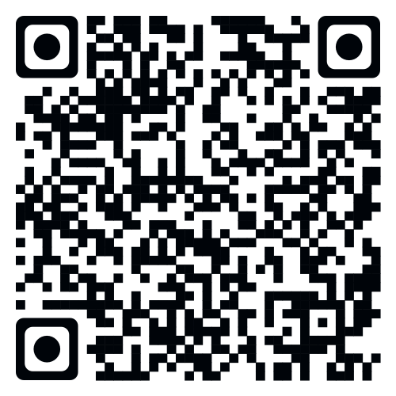
For more information on any of our Binnacle Training Certificate Courses please visit our website (or scan the QR Code):
binnacletraining.com.au/for-schools/programs

Slide 69
Allowing Teachers to Teach
HAVE A QUESTION?
CONTACT US
1300 303 715
admin@binnacletraining.com.au
binnacletraining.com.au

